Slide 1


Slide 2
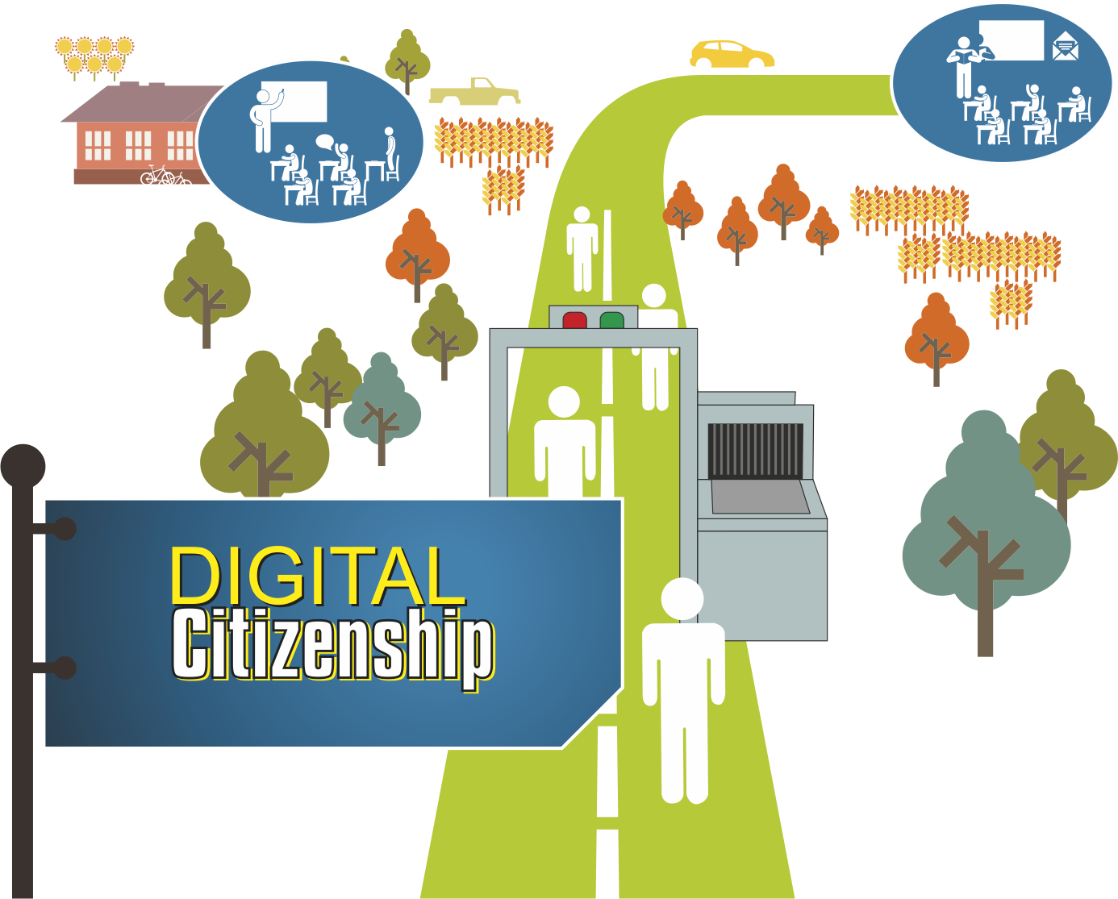

Slide 3
Digital citizenship
Where are you, and where are you heading?

Slide 4
Digital citizenship
Technology and social media play an increasingly critical role in the workplace and in education.
Notes:
What is the first thing that comes to mind when I make this statement?
Take a moment to think about it.

Slide 5
A
Technological devices and social media already play an important part in my personal and professional life. It is logical that they belong in the workplace.
I’m not entirely sure. I use technological devices and social media in my personal life, but I think they cause problems in the workplace.
Technological devices …? Do you mean like an electrical lawnmower?
Social media …? What’s that …?
B
C
Notes:
Which one of these options is closest to what you were thinking?

Slide 6
Digital natives are the future
Notes:
As the upcoming generations are our future, we will have to adapt to be able to speak their “language” and to prepare them for a future that we can only imagine in our wildest dreams.

Slide 7
“We need technology in every classroom and in every student and teacher’s hand, because it is the pen and paper of our time, and it is the lens through which we experience much of our world.”
–David Warlick

Slide 8



Slide 9
Facilitation
Breakaway sessions:
Planning (40 min)
  Tea break (30 min)
Good practice & policy (40 min)
Budget (40 min)
Breakaway sessions are static, with groups moving between the different venues.
10 min to move to the next venue.

Slide 10


